Slide 1
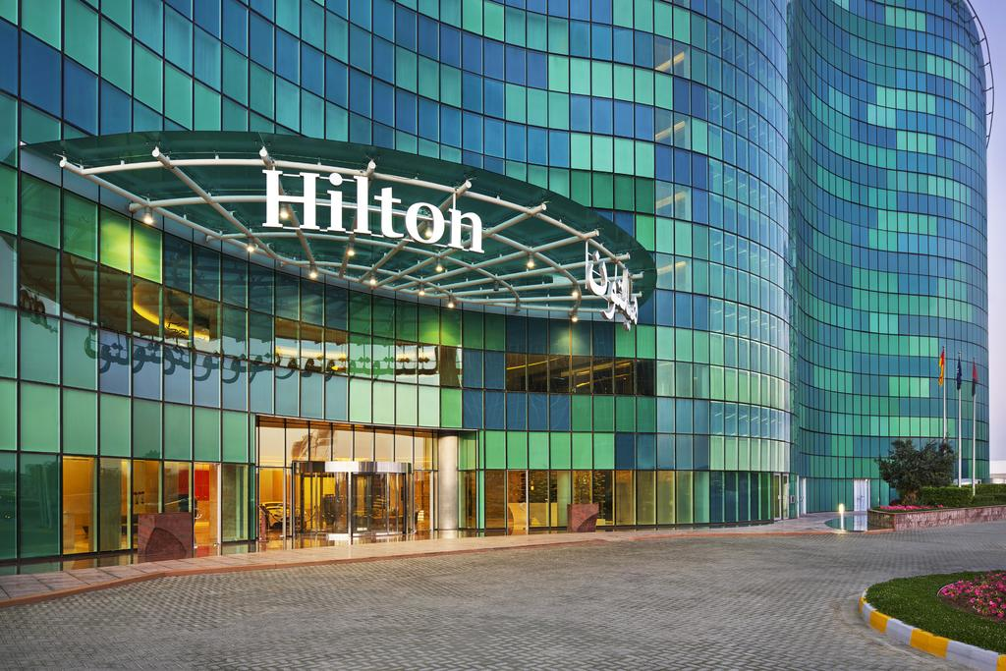

HOTEL BOOKING SYSTEM
By
Prabhat Johl
Meru Bhatnagar
Anupriya

Slide 2
Contents:
Objective
Project Architecture
Assumptions
ER Diagram
Data Dictionary
Queries and Business Requirements
Adding New Customer : Front End
Viewing Customer details: Front End
Constraints
Scope

Slide 3
Objective:
Hotel Hilton hosts individual or group customers. Main role is to accommodate family stay as well as event halls for different festivities and occasion.
The online Hotel Booking System is used to overcome the problem of redundant and false data by making complete atomisation of manual system to computerised system.

Slide 4
Project Architecture
Presentation Layer- HTML (Apache Server)
Application Layer- Python CGI
Database Layer - MySQL
We have implemented a 3- Layered Architecture for the project.
Used HTML Presentation layer as configured on Apache Server.
We have used python CGI scripting in Application layer where we have made the connection of front end with the database. Python CGI scripting is done for data validation and dynamic interfacing of front end applications.
My SQL is used for database layer for data extraction, manipulation and loading.

Slide 5
Assumptions:
A customer can strictly reserve one room per reservation
Customers can have guests with them.
Customers need to pay before the check in.
Event Booking will be done for customer and also for their guests if any.
Room Type are as follows:
Deluxe
Super Deluxe
King
Queen
Servant

Slide 6
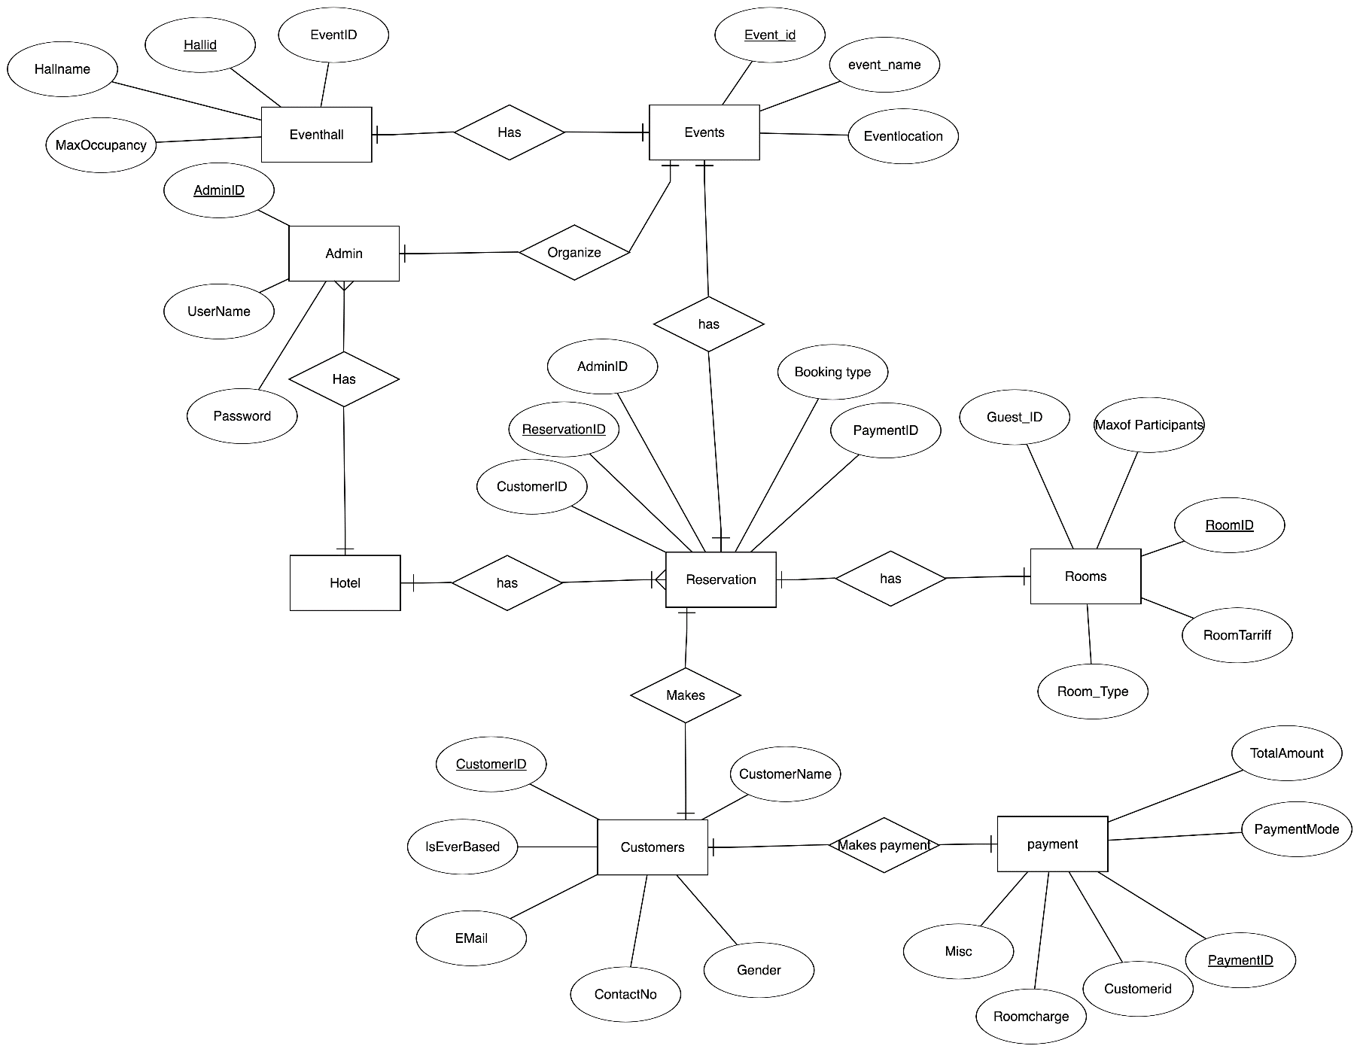
ERD

Slide 7
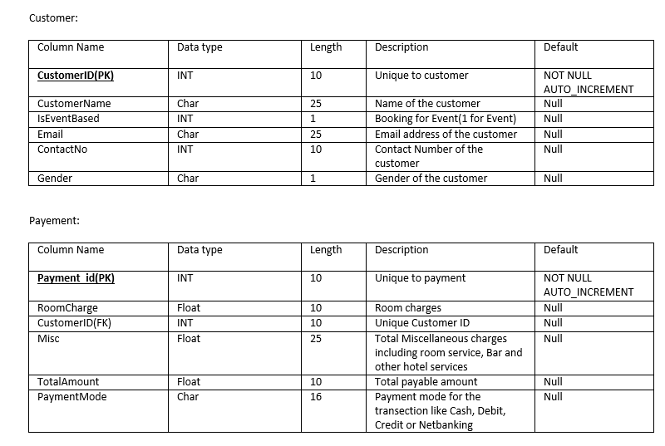
Data Dictionary:

Slide 8
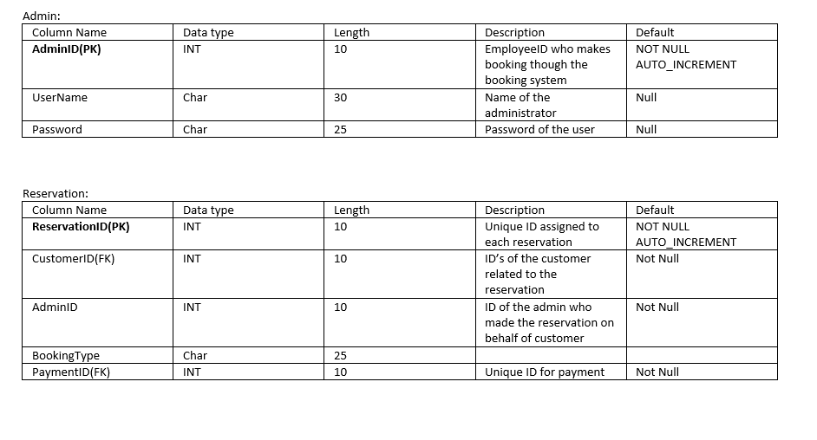
Data Dictionary:

Slide 9
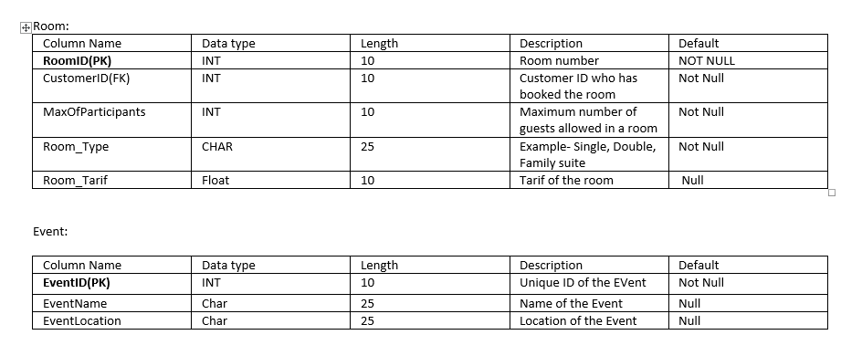
Data Dictionary:

Slide 10
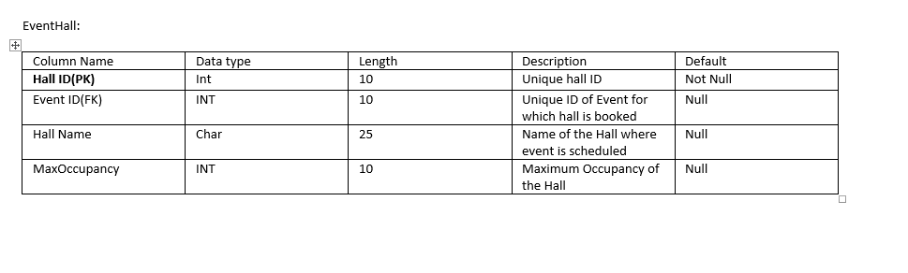
Data Dictionary:

Slide 11
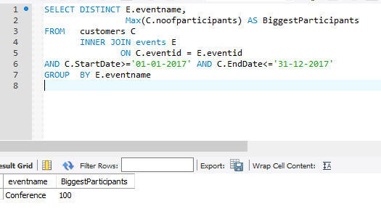
Queries and Business requirement
Event which has Maximum number of participant

Slide 12
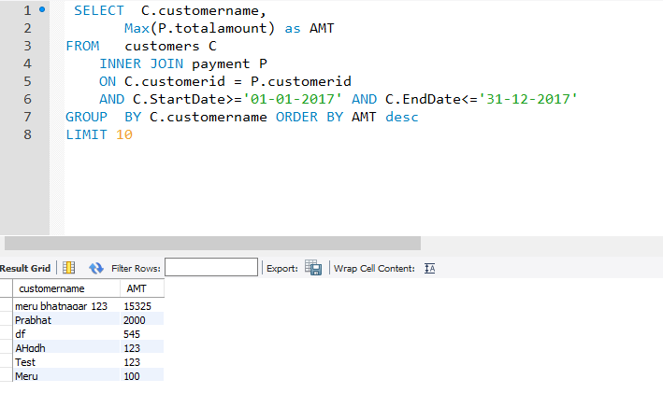
Frequent Customers, who have spent the most in the hotel.

Slide 13
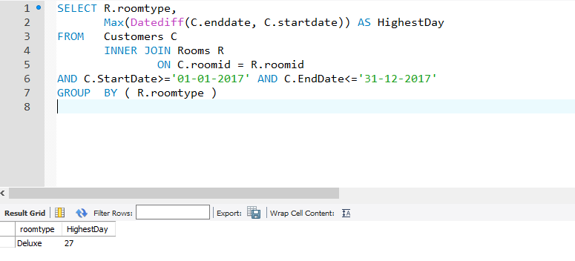
Roomtype which was occupied for Maximum duration:

Slide 14
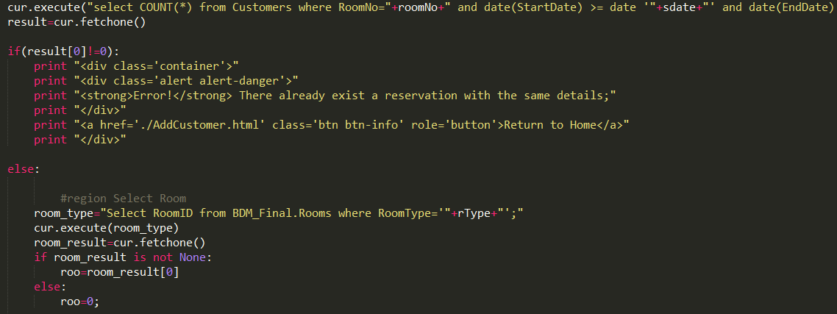
Room Booking Validation Snippet

Slide 15
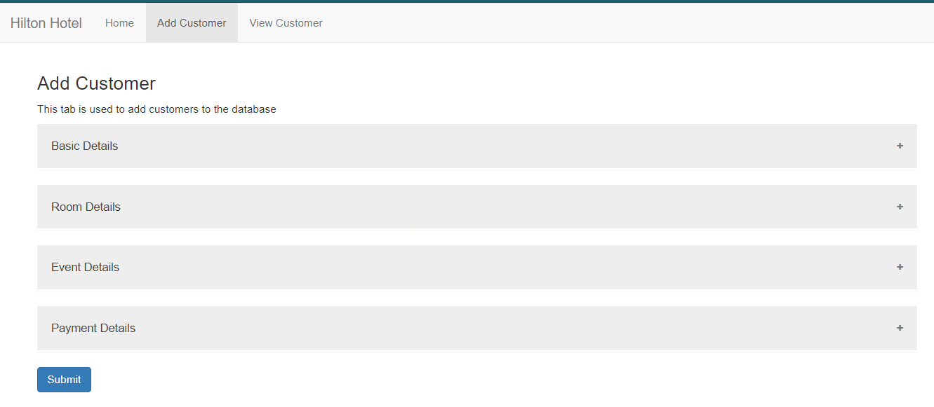
Adding New Customer

Slide 16
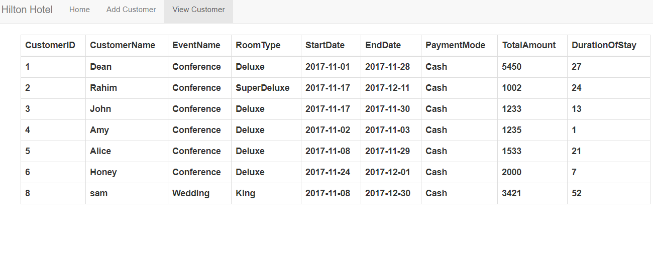
View Customer details

Slide 17
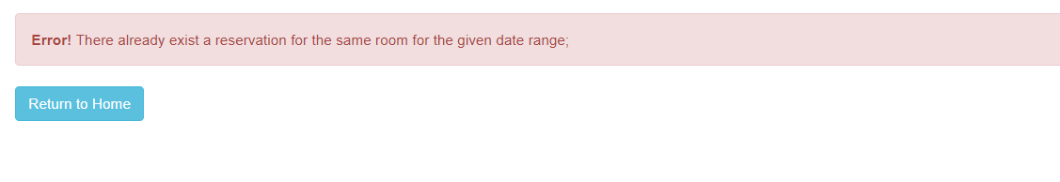
Error Message when Admin tries to make booking for the Booked room

Slide 18
Constraints:
1 booking can be of only 1 room type.
1 room type has a single rate.
1 event can be booked at a room at one time by 1 customer.
1 customer can book one event.
Events will be booked for customer type Group.

Slide 19
Scope:
A customer with many guests can book more than one rooms.
Reservation payment can be done online through secure bank portals.
Discounts can be provided to the customers in the future.
Reservations can be made for existing customers in the database.
Extend to Mobile based Applications.
Email Triggers to be introduced notifying customers regarding new offers and events.
A GUI based Admin panel for better reporting.

Slide 20
THANK YOU !!!

